Slide 1
Huffmann coding using tree data structure
By- Meenal Shah – PES2201800018
Partha Pratim Mishra – PES2201800366

Slide 2
Problem statement
Implement Huffman coding using tree data structure.
Perform encoding, decoding on a standard dataset.
Find out compression ratio with respect to uniform encoding

Slide 3
Introduction
What are trees ?
A tree is a widely used abstract data type (ADT) that simulates a hierarchical tree structure with a root value and subtrees of children with a parent node, represented as a set of linked nodes.
What is the objective of the project ?
The objective of the project is to encode a given dataset using Huffman coding and then calculate the compression ratio.

Slide 4
Problem description
What is Huffman coding ?
Huffman Coding is a famous Greedy Algorithm.
It is used for the lossless compression of data.
It assigns variable length code to all the characters.
The code length of a character depends on how frequently it occurs in the given text.
The character which occurs most frequently gets the smallest code.
The character which occurs least frequently gets the largest code.

Slide 5
Demonstration of Huffman Coding

Slide 6
Proposed Approach
First we , select an appropriate dataset. Since, Huffman is an algorithm that works using frequency of occurrences. We decided to select a dataset, that had a detailed numerical representation. This ensures that the representation is easy and detailed. The dataset then had to be cleaned of all ambiguous and NULL values.
The next step was to write the Huffman algorithm using tree data structure. In this step the concepts of Heaps and the basic definition of Huffman algorithm (mentioned in previous slides) was used.
The Code was checked with sample test cases before moving on with the integration of the dataset.
Th data set was converted into a structure of arrays and then accessed.
A separate dataset was also made to store the frequency of all distinct characters in the dataset which was implemented in the code.

Slide 7
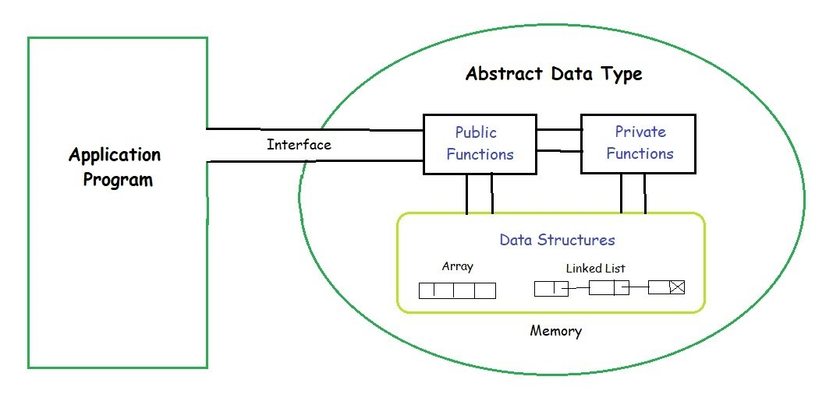
Abstract Data types
ADT (or Abstract Data Types) is a type (or class) for objects whose behavior is defined by a set of value and a set of operations.
The definition of ADT only mentions what operations are to be performed but not how these operations will be implemented. It does not specify how data will be organized in memory and what algorithms will be used for implementing the operations. It is called “abstract” because it gives an implementation-independent view. The process of providing only the essentials and hiding the details is known as abstraction.

Slide 8
Huffman coding – detailed descriptions
Huffman code is a data compression algorithm which uses the greedy technique for its implementation. The algorithm is based on the frequency of the characters appearing in a file.
What is the greedy technique ?
Greedy algorithm greedily selects the best choice at each step and hopes that these choices will lead us to the optimal solution of the problem. Of course, the greedy algorithm doesn't always give us the optimal solution, but in many problems it does.

Slide 9
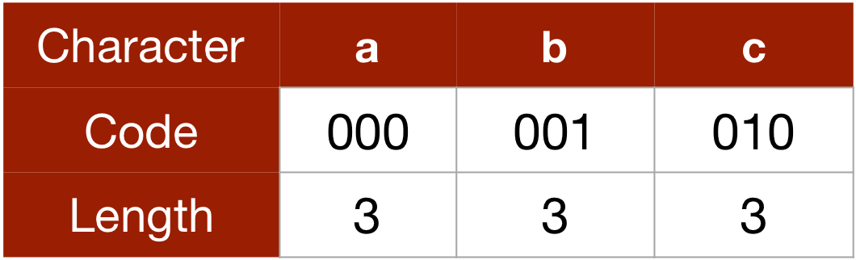
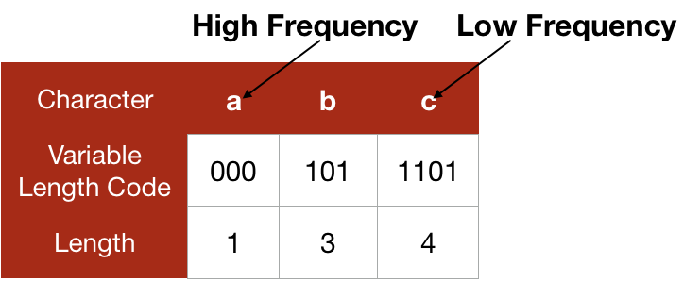
Continued…
We know that our files are stored as binary code in a computer and each character of the file is assigned a binary character code and normally, these character codes are of fixed length for different characters. For example, if we assign 'a' as 000 and 'b' as 001, the length of the codeword for both the characters are fixed i.e., both 'a' and 'b' are taking 3 bits.
Huffman code doesn't use fixed length codeword for each character and assigns codewords according to the frequency of the character appearing in the file. Huffman code assigns a shorter length codeword for a character which is used more number of time (or has a high frequency) and a longer length codeword for a character which is used less number of times (or has a less frequency).

Slide 10
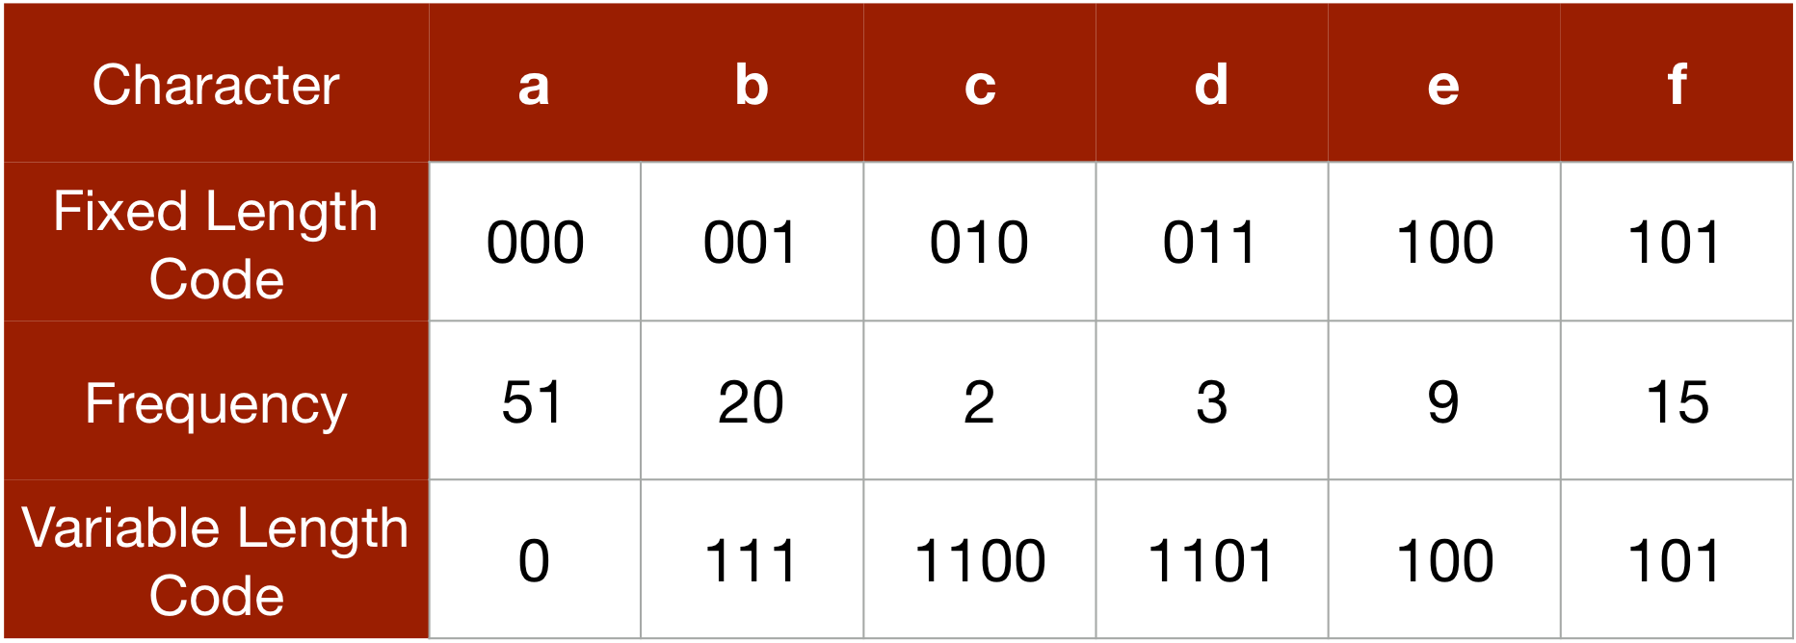
In this example, 'a' is appearing 51 out of 100 times and has the highest frequency, 'c' is appearing only 2 out of 100 times and has the least frequency. Thus, we are assigning 'a' the codeword of the shortest length i.e., 0 and 'c' a longer one i.e., 1100.
Now if we use characters of fixed length, we need 100*3 = 300 bits (each character is taking 3 bit) to represent 100 characters of the file. But to represent 100 characters with the variable length character, we need 51*1 + 20*3 + 2*4 + 3*4 + 9*3 + 15*3 = 203 bits (51*1 as 'a' is appearing 51 out of 100 times and has length 1 and so on). Thus, we can save 32% of space by using the codeword for variable length in this case.
Also, the Huffman code is a lossless compression technique. You can see that we are not losing any information, we are just using a different way to represent each character.

Slide 11
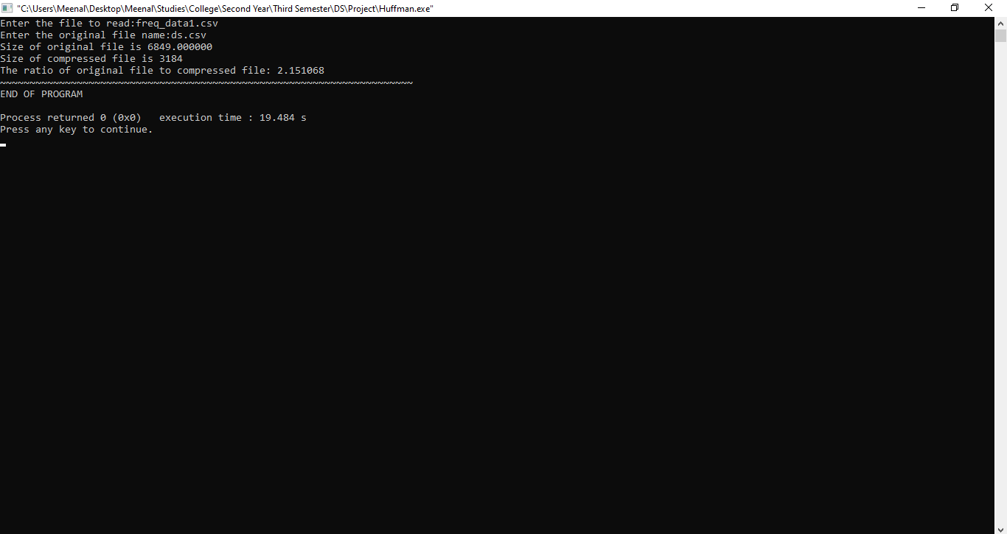
EXECUTION SNAPSHOT

Slide 12
THANK YOU

